Slide 1



Invited Talk
CSG Meeting:
fMRI pipelines comparison
and process enhancement
Stephen Larroque
Coma Science Group, GIGA Consciousness
University of Liège
11/08/2017
Notes:
If I talk about “issues”, it is in the context of the fmri analysis process, it is NOT meant to blame anyone ☺

Slide 2
Outline
FMRI pipeline comparison:
Code analysis
Segmentation
Denoising
First-level
Second-level
Other consderations:
Threshold tweaking
Others (manips, etc)
Conclusion
Notes:
I will do some recommendations but this is more as a way to open the discussion rather than a definitive thing. At the end, a recap document will be written with all decisions (need someone to write down??).

Slide 3
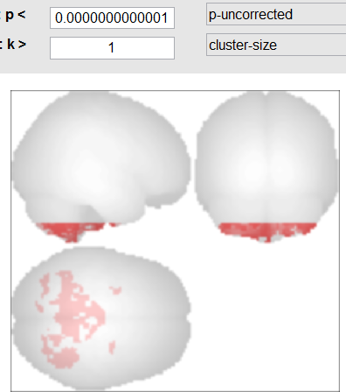
Background: Why?
Issues identified in new pipeline:
Cerebellum artefact
Signal shape tampered, only noise remains (easy to spot on CONN Denoising and 1st-level previsualizations when compared to other pipelines)
Controls were preprocessed with a different pipeline (no idea which one, can be as old as Lizette's SPM8 pipeline).
Current pipeline not validated (uses NewSeg).

Slide 4
fMRI pipelines: Code analysis overview
Code & batch comparison using KDiff3 + manual inspection
7 packages (total: 18 pipelines scripts) reviewed:
Stephen's
Athena's script for classifier
Athena's script for cosmonauts
Athena's from Charlène computer
Lizette's
Carol's
Charlène's FMRI+PET scripts (latest used as of 06/2017)
Each package contained 1 to 6 different pipelines with an average = 3. “Athena’s only” average = 1, “rest only” average = 4.
Notes:
Multiple scripts per package

Slide 5
fMRI pipelines: Code analysis results
Analysis goal: Isolate major differences and ignore cosmetic changes (eg, different directories layout, non-critical parameters such as filepaths or TR due to migration)
Significant changes included different versions of softwares (SPM8 vs SPM12, with or without VBM8/DARTEL, etc.), different modules versions (OldSeg vs NewSeg), critical parameters changes (eg, using another TPM template) and pipeline format (code+batch vs code only).
4 different scripts families were isolated:
SPM8 script no batch (Lizette, 2015?, Spatial_processing_Lizette*.m)
SPM8+VBM8/DARTEL with batch (Carol, 2016, script_preproc_VBM_Dartel_DEF*.m). Note: Charlene has a variant VBM8+PET.
SPM12 OldSeg with batch (Athena, 2016-2017, script_preproc_LIE_spm12.m)
SPM12 NewSeg CRC12 tpm+PET with batch (Charlène, 2017, script_preproc_SPM12_Charlene.m)
Note: for the rest of this presentation, only scripts 2, 3 and 4 willl be used.

Slide 6
fMRI pipelines: Code analysis results
SPM12 OldSeg (Athena’s) script is the most stable (in terms of code): always the same in all instances analyzed. Pro: very fast, should fit most functional analyses + classifier.
3 different templates:
spm8 Dartel custom patients template
spm12 no template (use standard)
spm12-NewSeg uses CRC12 custom template.
Several inconveniencies :
difficult to migrate (all templates and software paths hardcoded or hidden in batch)
easily breakable (PATH with multiple software versions, no apriori check of TR, of files existence, etc.) → script stops in the middle of preprocess instead of before
accents and long filenames unsupported and no check
4d nifti unsupported
Notes:
(shameless plug: I fixed all of the above in my script ;) )

Slide 7
fMRI pipelines: Images comparisons
Additional technical notes with the companion .txt file (with all equivalences).
Now the boring part is done, we can check the resulting images with each pipeline ☺

Slide 8
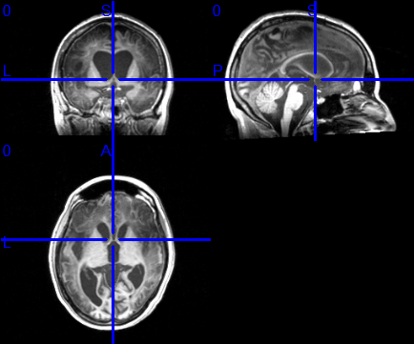
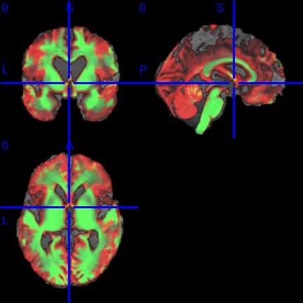
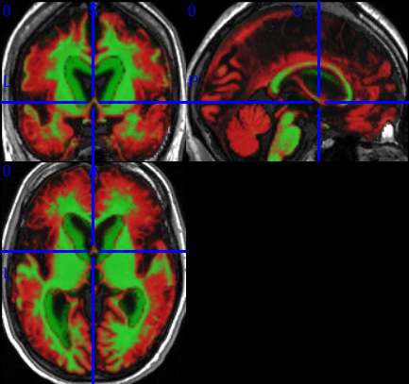
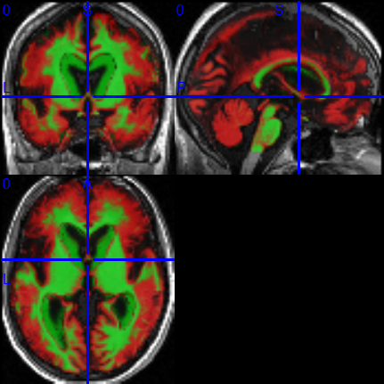
fMRI pipelines: Segmentation
T1 original
SPM8+VBM
Notice
the
Cerebellum
Cut!
SPM12
OldSeg
SPM12
NewSeg

Slide 9
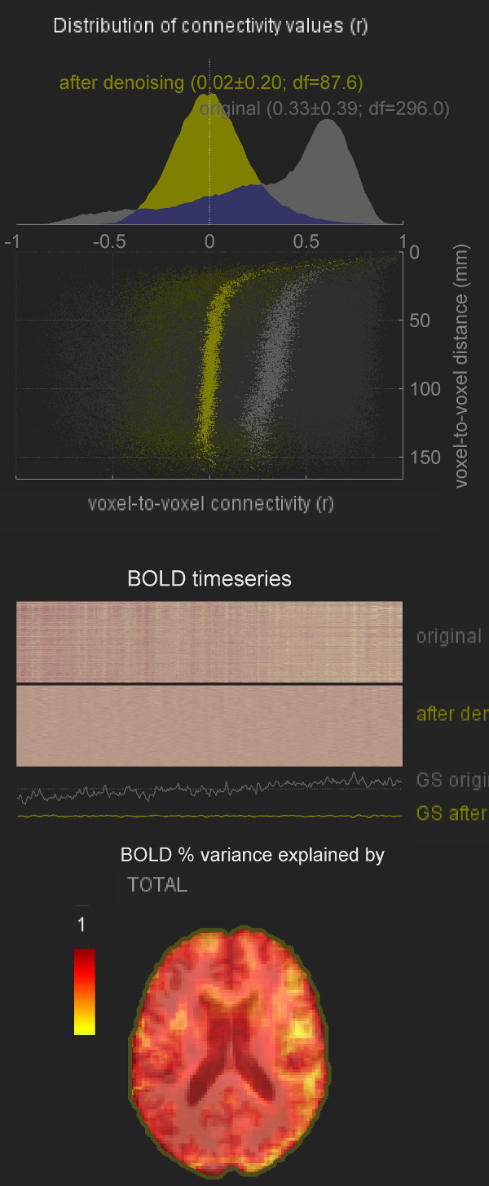
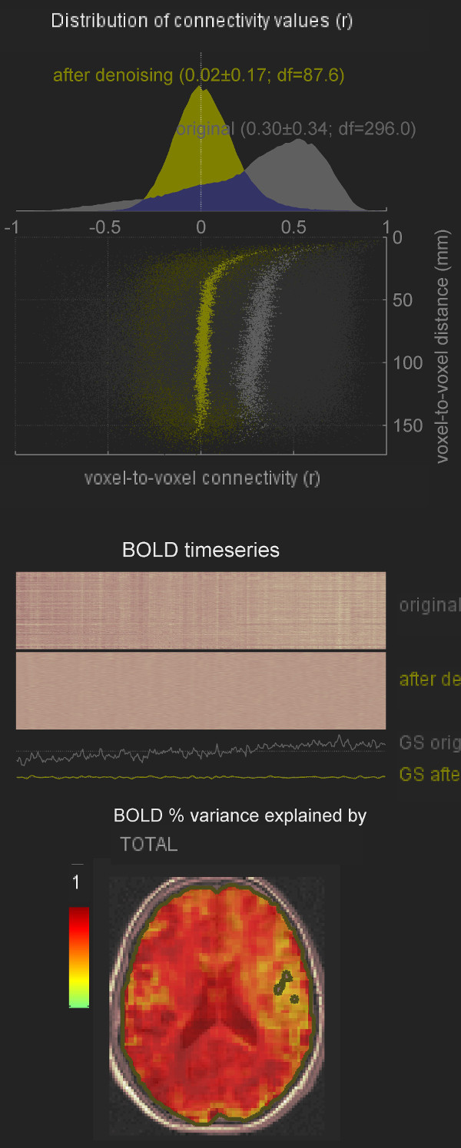
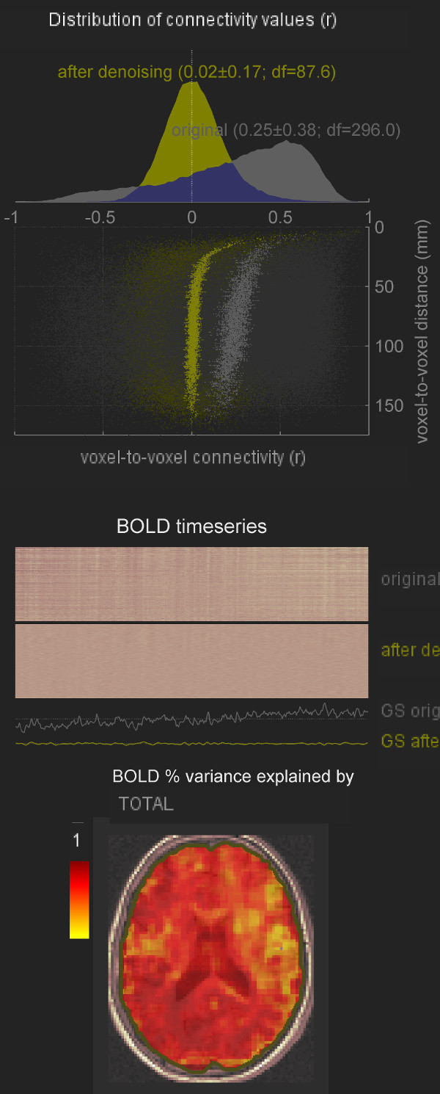
fMRI pipelines: Denoising Controls
SPM8+VBM
SPM12 OldSeg
SPM12 NewSeg

Slide 10
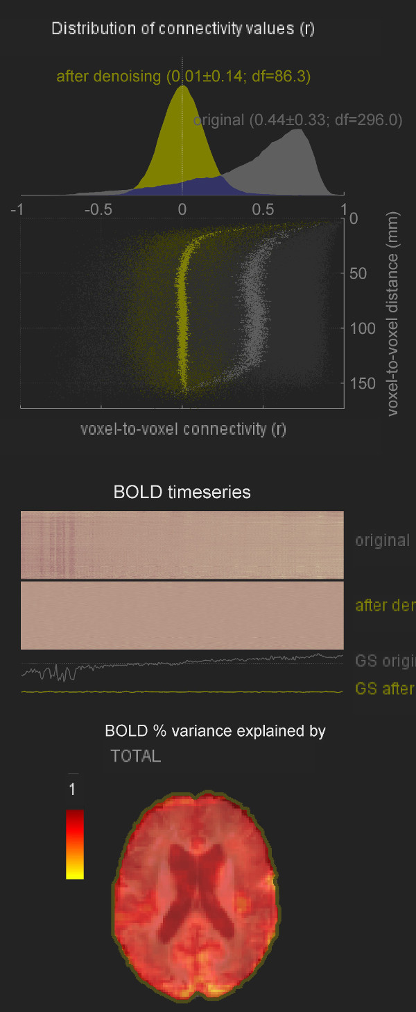
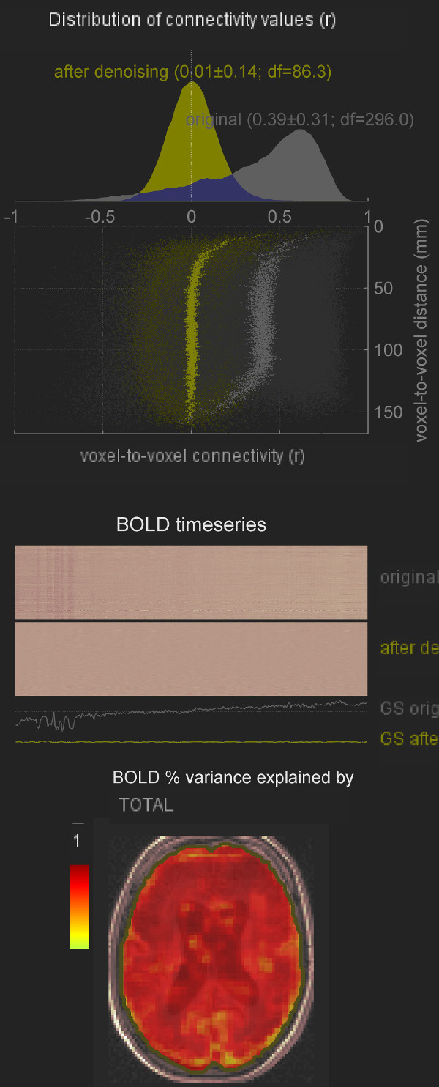

fMRI pipelines: Denoising Patient
SPM8+VBM
SPM12 OldSeg
SPM12 NewSeg

Slide 11
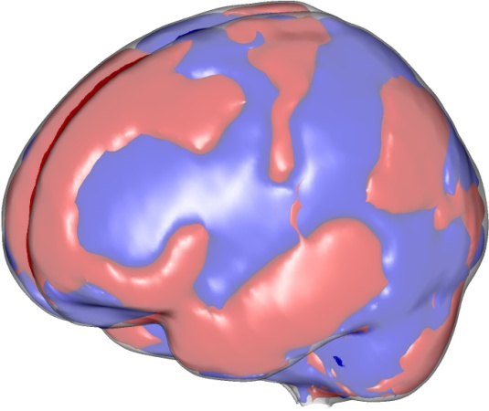
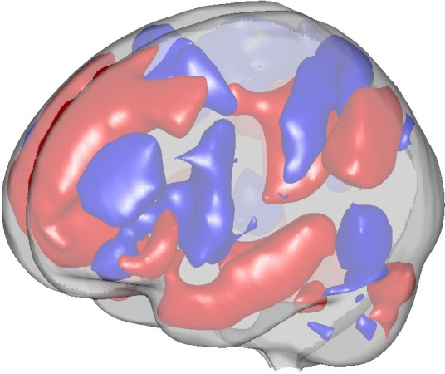
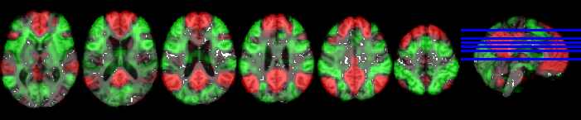
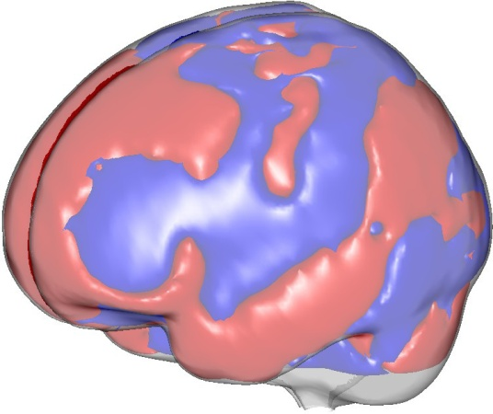
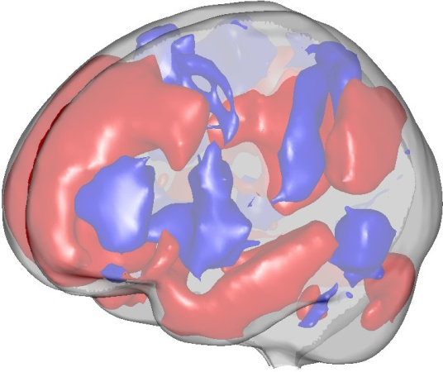
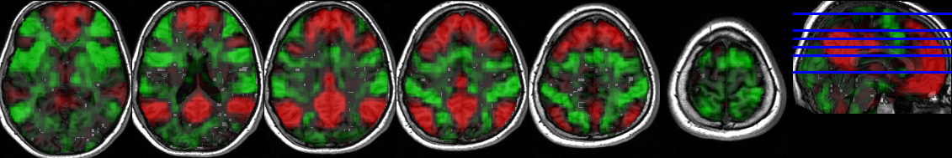
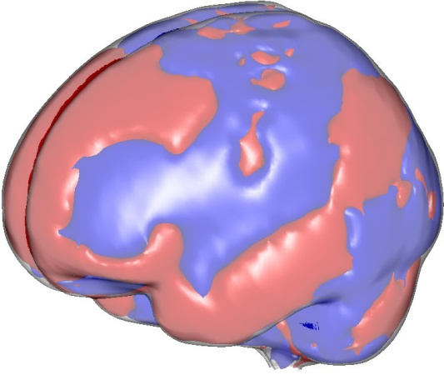
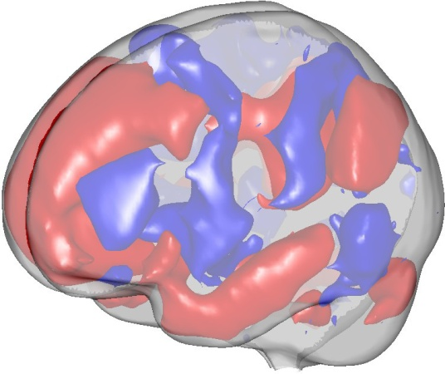
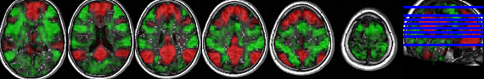
fMRI pipelines: First-Level Controls
(averaged on all 8 controls)
Binarized
Threshold Z >= 0.1
SPM8+VBM
SPM12 OldSeg
Cerebellum cut again!
SPM12 NewSeg

Slide 12
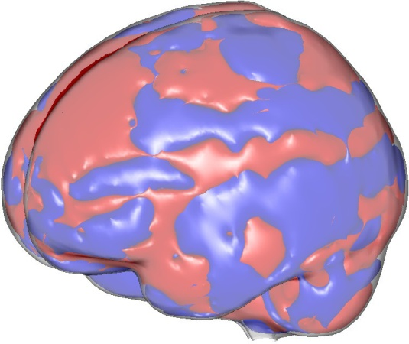
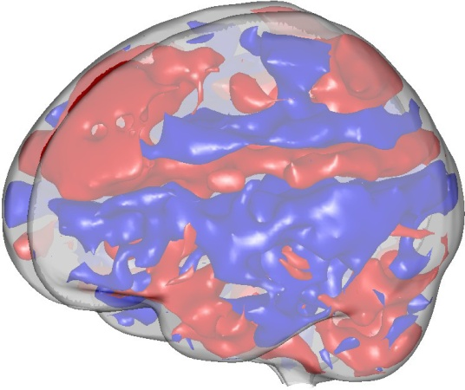
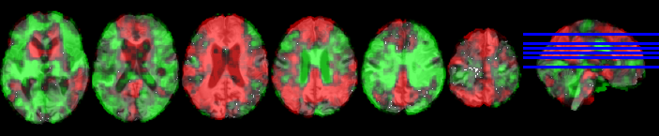
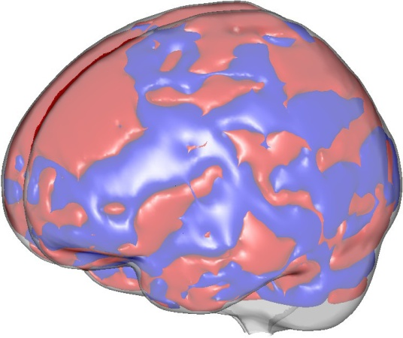
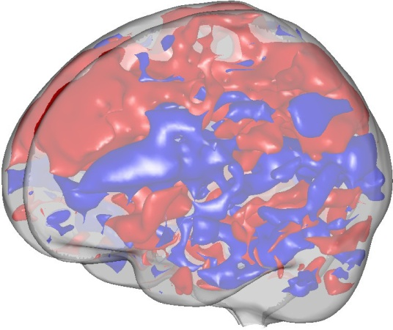
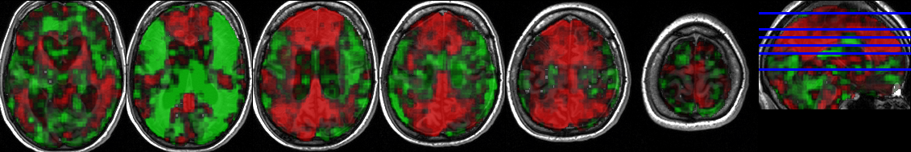
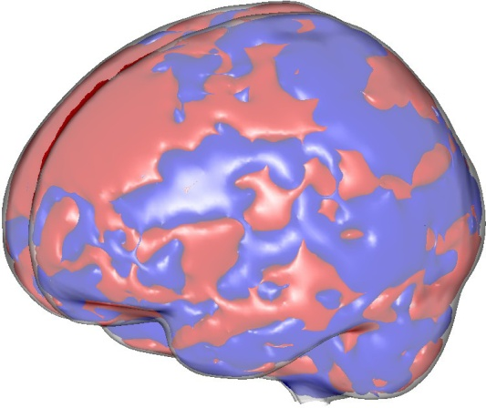
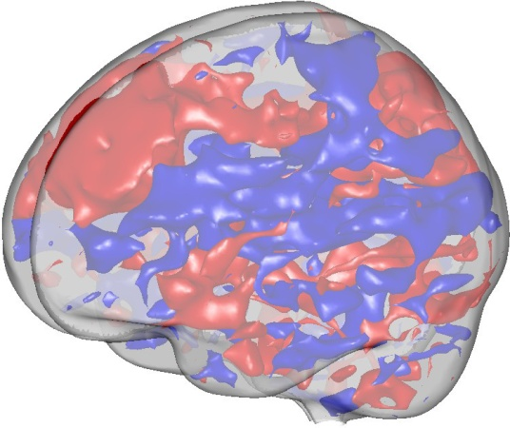
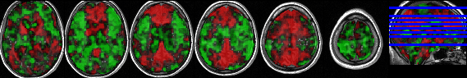
fMRI pipelines: First-Level Patient
Binarized
Threshold Z >= 0.1
SPM8+VBM
SPM12 OldSeg
SPM12 NewSeg

Slide 13
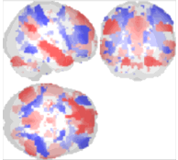
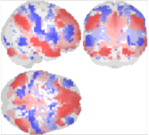
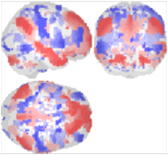
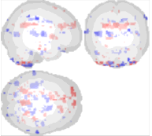
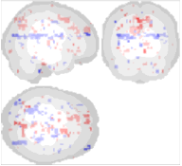
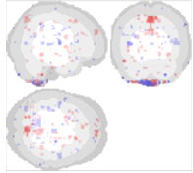
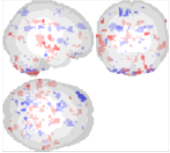
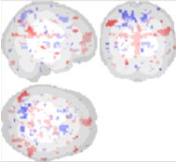
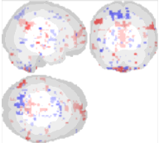
fMRI pipelines: Second-Level
Pipeline
SPM8+VBM
SPM12 OldSeg
SPM12 NewSeg
Group
Controls average
Patient average
Contrast
Controls>Patients
p <= 0.01
No cluster corr.
Notes:
What is the most plausible?

Slide 14
fMRI pipelines: propositions
Maintain 2 functional preprocessing pipelines: SPM12 OldSeg & SPM8/VBM (Alternative: use CONN standardized preprocessing.)
Unify into one script if possible (reproducibility & maintenance, most of the code logic is the same! Only the batch change)
Systematic versioning & centralized repository (petabyte "Softwares“ or GitHub):
Versioning: ease tracking down original and compare/integrate user changes.
Centralized repo: code reviewing (less bugs) and easy update.
Validate new pipelines before deployment: run both current and new pipeline for 1 patient and compare.
Freeze version of SPM & CONN (& other necessary softwares) on Z:. Before updating, validate like any new pipeline.

Slide 15
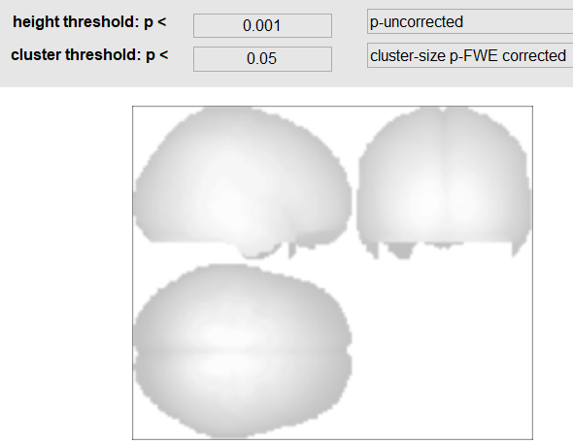
Threshold tweaking
Necessary when only one patient, not enough power
What is acceptable for clinical? What is the most plausible?

Slide 16
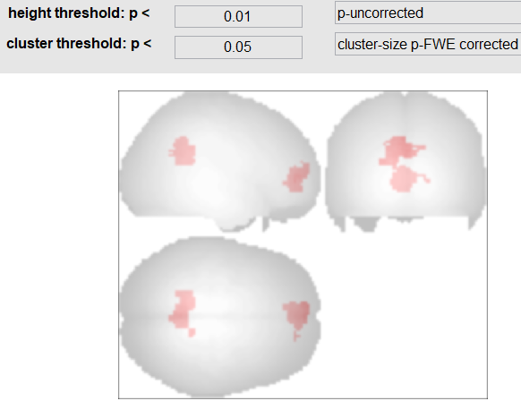
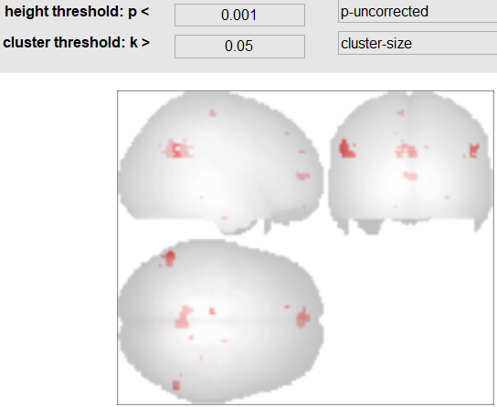
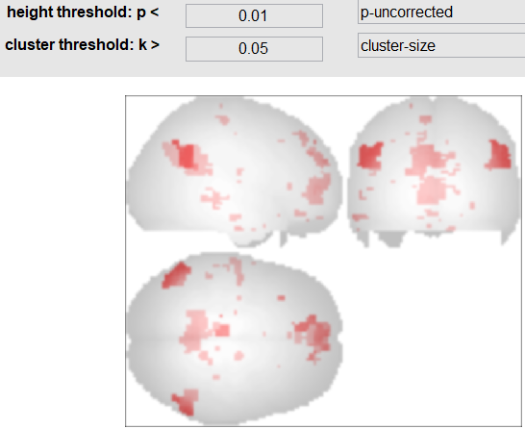
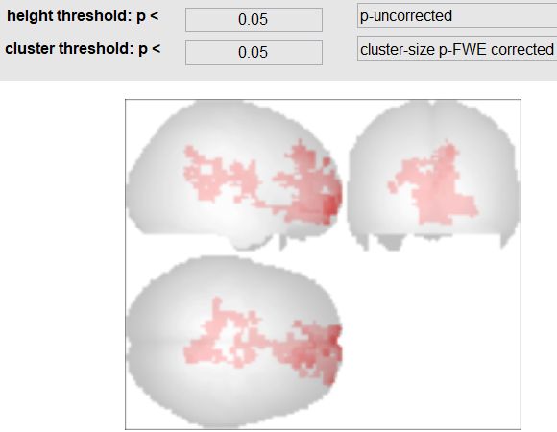
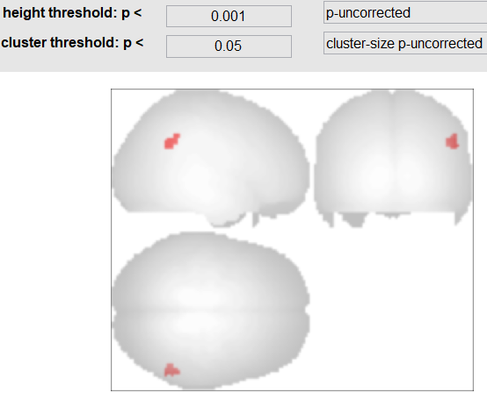
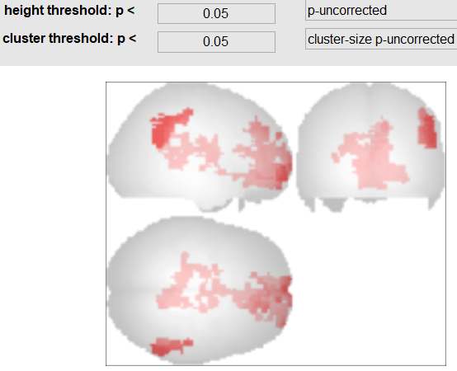
Threshold tweaking
Lower height/voxel-wise
threshold
No cluster-wise
correction
Both
Notes:
What is the most plausible?

Slide 17
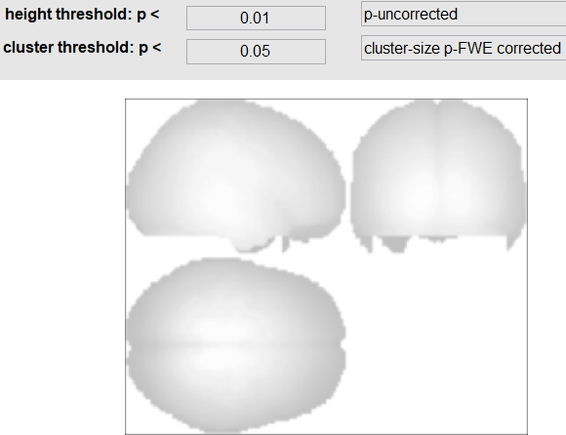
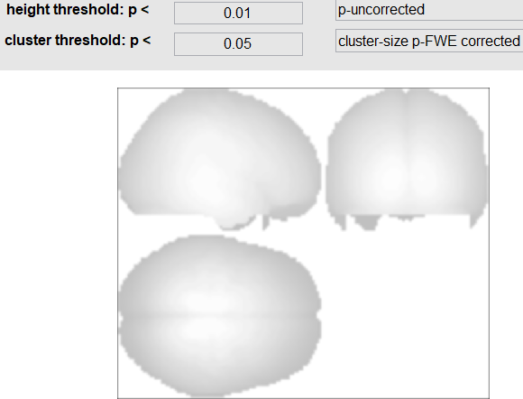
Visualization is not really two-sided
Positive
Negative
One-sided
Nothing to show!
Because corrects for
both positive and negative
simultaneously!
Two-sided

Slide 18
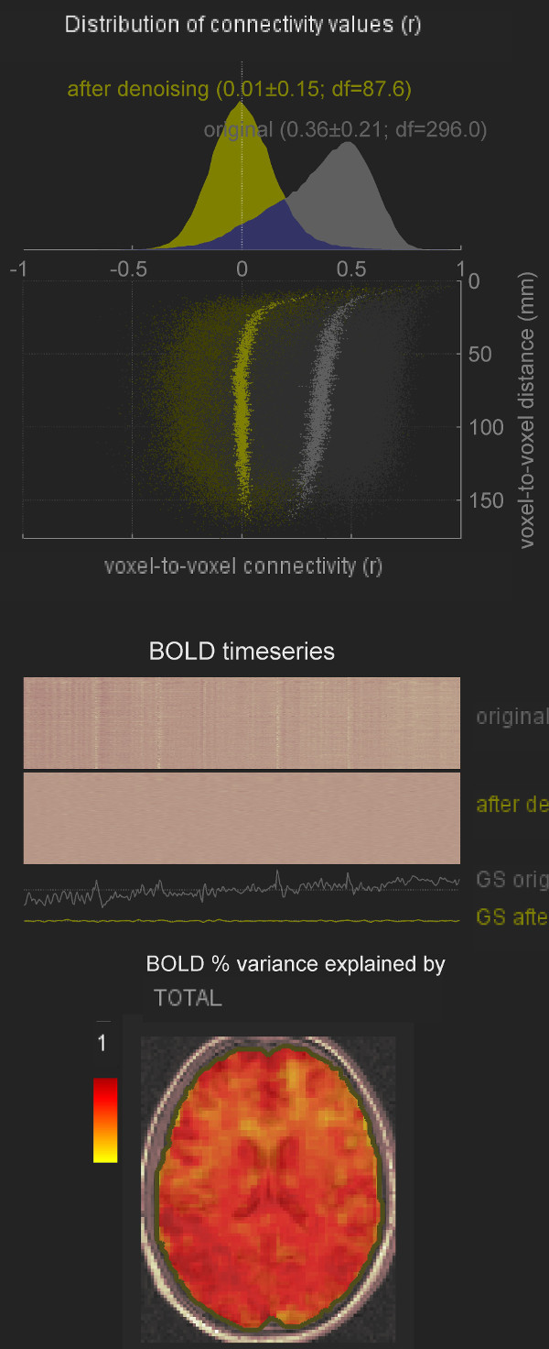
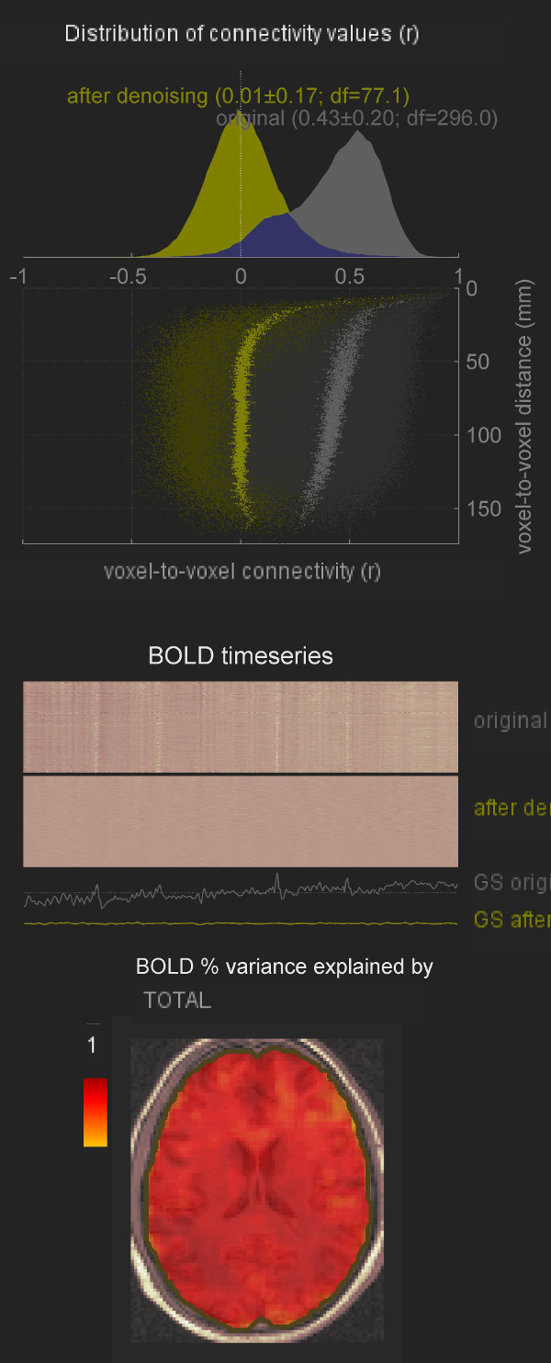
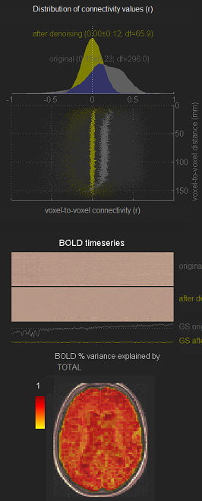
Manipulation errors & QA
Control
no smooth/realign
Patient
no smooth/realign

Slide 19
Manipulation errors & QA
Cause of noisy
signal shape!
Control
no smooth/realign
Patient
no smooth/realign

Slide 20
Other considerations
Mixed controls: controls were not reprocessed (different normalization, smoothing kernel, modules versions, resizing, etc.)
Template is CRITICAL: if bad template, the results will be totally wrong! (Use CONN overlay on MNI to QA)
NaN are CRITICAL: if you include multiple patients in one CONN project, don’t just set to 0, else all patients/subjects are used, including the ones you are trying to exclude! Thus artificially inflating effect size significantly! Inputing NaN instead of 0 will exclude subjects.
Lizette mentioned that they did not use VBM/DARTEL at the time to « be able to trust the classifier » ?
Interesting: If wrong TR and slice order (slice timing correction), MPFC seed lost all correlation, but not PCC (no change after correction).
Ask Mohamed: why in new VBM8 script, coregister on original structural, instead of VBM bias corrected?

Slide 21
Propositions
Automate CONN project creation: use conn subjects loader script to minimize manip errors
Always check Denoising step for very weird artifacts
Reprocess controls everytime we use a new pipeline (else not comparable! eg, normalization different, smoothing kernel can be bigger, etc.)
Always write threshold used in report (voxel p and cluster p)
For research: save copy of scripts used on Z: after study finished (to know version, parameters, modules used, etc.)
Should always use cerebellum masking?
Notes:
Denoising: not necessarily do an expert quality assessment, just if you see something weird report it!
Controls probably not smoothed with same kernel
and not same preprocessing: swaf instead of s6rwaf. So no resize!
and from folder restMotionProcessed instead of restMotionCorrected (but for patients it is restMotionCorrected). But only the name change, files are the same. But advised to sue restMotionCorrected always for consistency.
QA: at denoising, should ALWAYS be Gaussian like, because of the smoothing! If it is not, then the smoothing was not done!
Use our conn loader tool to avoid manipulation errors. Also we do not lose anything, if there is an issue someday, we can reuse the conn projects generated with the script for previous subjects, just like we are doing today!

Slide 22
Conclusion
All pipelines are good, it is just difficult to migrate (and to learn how to use them)
One very stable pipeline, used for years (SPM12 OldSeg/Athena’s). Should use that!
Version, centralize, unify & fix code potentially useful to reduce errors or be more descriptive (parameters for easy migration, conn subjects loader, fix bugs or message) (also it will be faster for users ☺) → updated SPM12 OldSeg already done, eventually merged with Mohamed’s code on GitHub? ☺
VBM should be kept, but mostly for research (where segmentation matters & more conservative results). → Move to CAT12? (better report and segmentation more customizable, encouraging first results)
Notes:
Migration = when a user gives the script to someone else, need to change several hidden parameters and to have exactly the same software versions and correct PATH!
Make experimental SPM12 + CAT12 for better segmentation & subject space high-dimensional per tissue projection (for research!). This will replace SPM8+VBM8 script used by Carol (Lancet paper etc).

Slide 23
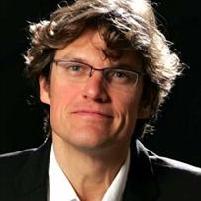









Steven Laureys
Carol Di Perri
Thank you for your attention

Slide 24
Thank you for your attention
References:
N/A

Slide 25
BONUS SLIDES

